Slide 1
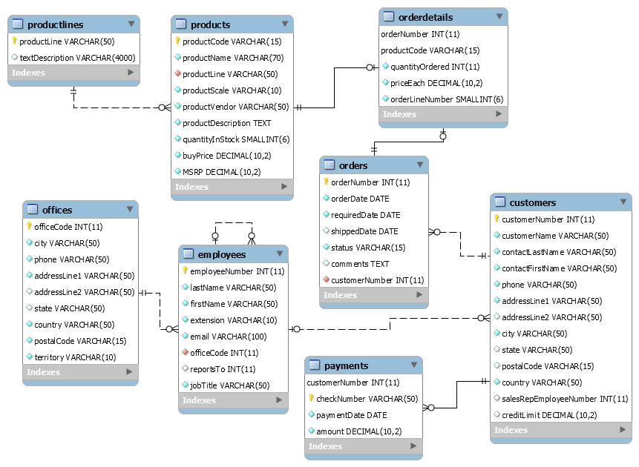
‘Boston Motors’ - Online retail application for selling vehicles
- Dharini shah

Slide 2

‘bostonmotors,’ originally from Boston has branches all over the world. Information regarding all their offices, is in the office table.
They sell different types of vehicles like cars, bikes, trucks. Each category is present in product_lines. Actual entity is present in products.
Information regarding bostonmotor employees is in the employees table; an employee may have a supervisor, who is also the employee of bostonmotors ; customer information is in the customers table
Order table contains details regarding each order; each order may consist of multiple products; information at product level is stored in the order_details table. Note that, order_detail is a dependent entity on orders; It cannot exist without orders – Such tables are also known as weak entities.
Payment info, is present in payments table and it cannot exist without customers.
Notice the solid line in the ERD between customer – payments, product-orders_details, order- product-orders_details, as opposed to dotted lines. These represent ‘Identyfying Relationships’
When you create an identifying relationship, the primary key of the child table becomes a foreign key in the parent table. In non-identifying relationships, the primary key of the child table is still included as a foreign key, but it doesn’t get to participate as a primary key. Hence, it is non-identifying.

Slide 3
Cardinality(MAX): two options - one or many. Modality(MIN): O, 1 or MANY Crow notation
A product line can have 0,1 or many products; Each product must belong to exactly one product_line
An office can have 0,1 or many employees; Each employee must belong to exactly one office
An employee may have at-most one supervisor, Each supervisor may supervise one or many employees
Each order may have one/many order_details; Order_details must belong to exactly one order
Each order details will have exactly one product; each product may belong to atmost one order details
A customer may place one/many orders; Each order must belong to a customer
A customer may have one/many payments; Each payment must belong to a customer

Slide 4
SQL BASICS, SELECT QUERY AND FILTERING

Slide 5
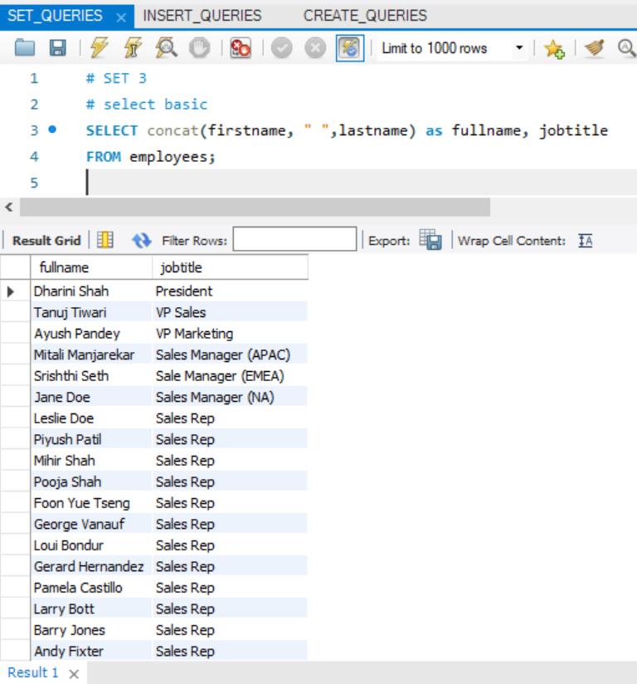
SELECT
SELECT concat(firstname, " ", lastname) AS fullname, jobtitle FROM employees;
CONCAT() – concatenate strings
AS – alias
SQL TIP:
using as is optional
If using Auto increment, corresponding column is not necessary in Insert query as it will get auto incremented

Slide 6
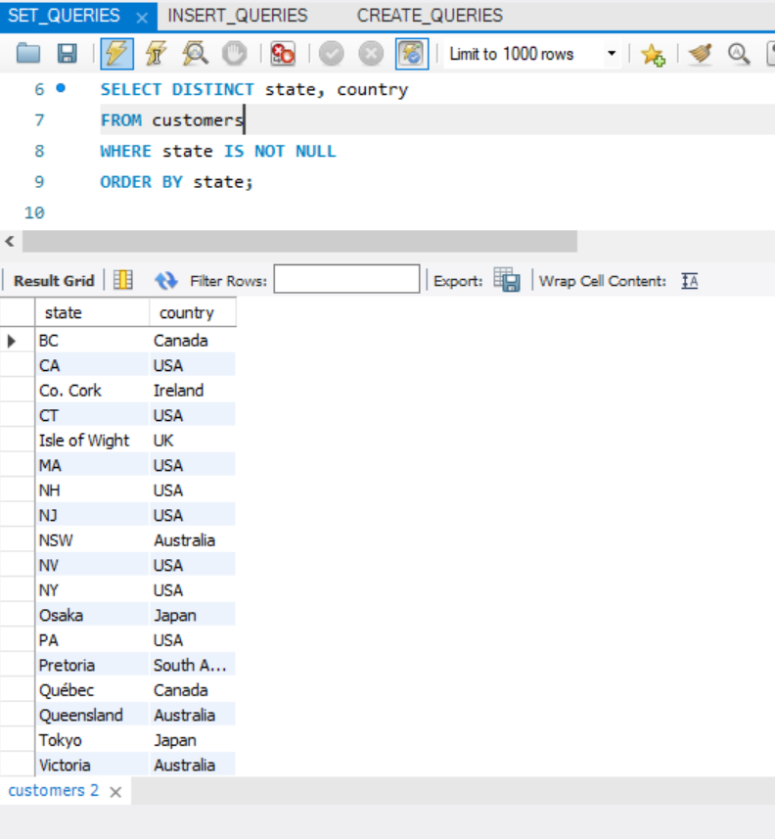
SELECT
SELECT DISTINCT state, country FROM customers WHERE state IS NOT NULL ORDER BY state;
DISTINCT -> to get unique names,
IS NOT NULL -> to remove all customer entries that have null as state value

Slide 7
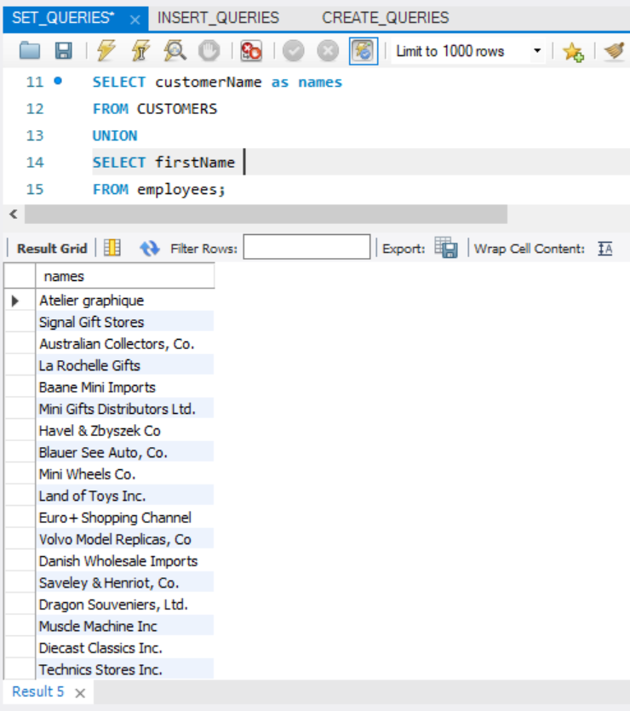
SELECT
SELECT customerName as names FROM CUSTOMERS UNION SELECT firstName FROM employees;
UNION – combines results of 2 tables, by default gives unique values
UNION ALL – gives duplicate entries as well

Slide 8
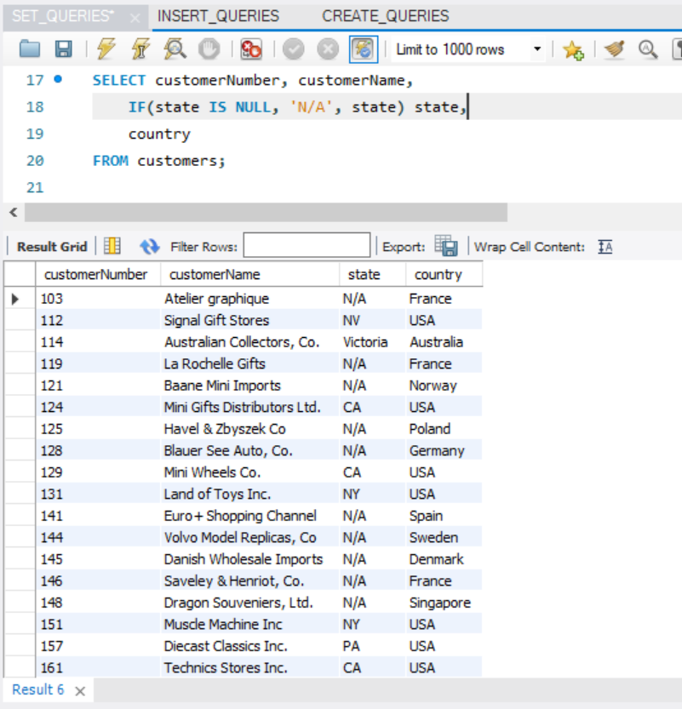
SELECT
SELECT customerNumber, customerName, IF(state IS NULL, 'N/A', state) state, country FROM customers;
SQL Tricks: Use control-flow statements,`IF` to replace NULL values by desired texts like ‘N/A’

Slide 9
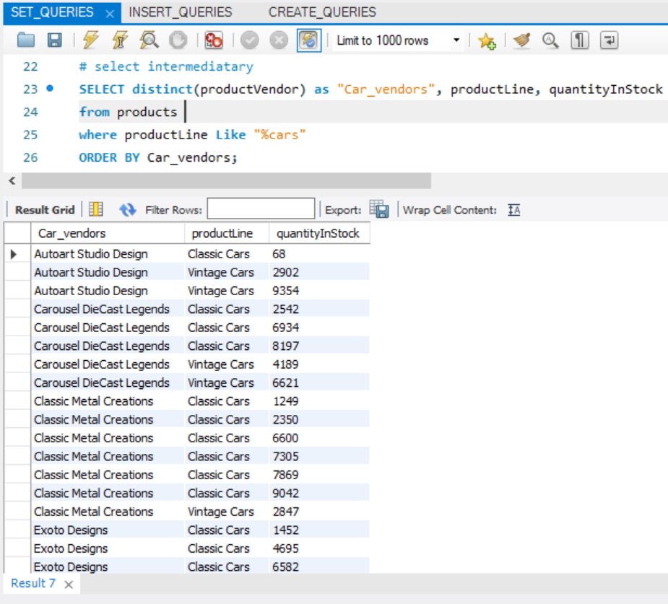
SELECT
SELECT distinct(productVendor) as "Car_vendors", productLine, quantityInStock from products where productLine Like “%cars” ORDER BY Car_vendors;
LIKE Operator – return product lines that end with “cars”.
%: any number of characters, _: exactly one character
ORDER BY -> sort; default ascending. Change sort order using desc

Slide 10
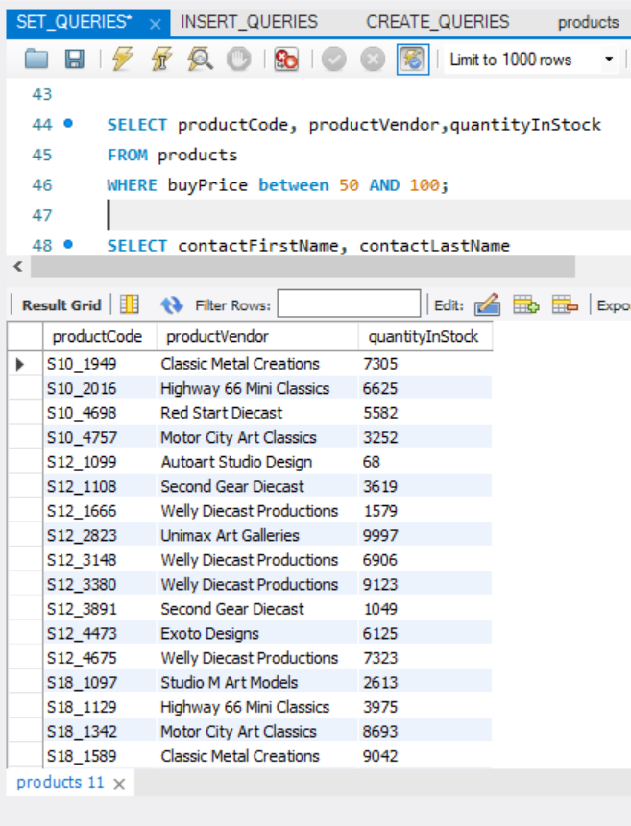
SELECT
SELECT productCode, productVendor,quantityInStock FROM productsWHERE buyPrice between 50 AND 100;
BETWEEN : faster way of writing
a >= AND a <=
Note that its inclusive of both end points

Slide 11
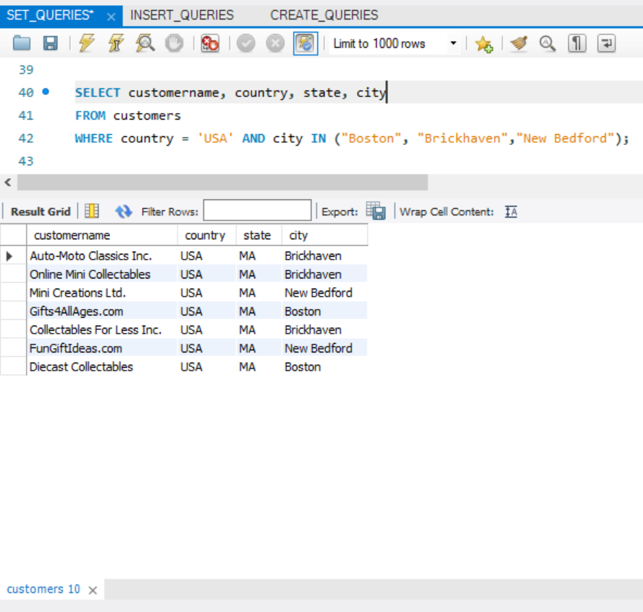
SELECT
SELECT customername, country, state, cityFROM customersWHERE country = 'USA' AND city IN ("Boston", "Brickhaven","New Bedford");
IN -> compare from a set of values
Example, check if city is any of (Boston, Brickhaven, New Bedford)

Slide 12
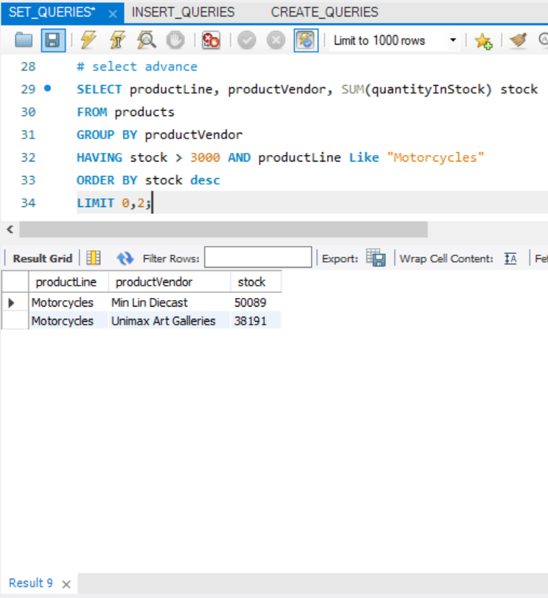
SELECT
SUM() aggregate function, sum quantity.
SUM() stock -> alias given as stock to sum() without using AS
For using aggregate functions use Group by. The MYSQL GROUP BY Clause is used to collect data from multiple records and group the result by one or more column
Having clause, used to filter result of group by – CANNOT USE WHERE cause of aggregation
Comparison operators: >, < =, != or <>, <=, >=
AND – used when more than one filters need to be satisfied. AND – mandatory, OR – optional
LIMIT – to restrict the number of rows -> in this case I wanted TOP 2 records, so I first ordered by ‘Desc’ then limit by 2
SELECT
FROM
GROUP BY
HAVING
ORDER BY
LIMIT
Notice carefully, this query is doing a lot of things!!!

Slide 13
TO CONCLUDE, FILTERING DATA IN MySQL
WHERE: specify a selection criteria to select the required records from a table
SELECT DISTINCT: helps us remove duplicates
AND, OR: used usually along with where/having to compare more than one selection criteria's
IN: if a specified value matches any value in a set of values; ANY, SOME, or ALL
BETWEEN: selects values within a given range. Inclusive
LIKE: compare with a string, % , _
LIMIT: restrict number of rows
IS NULL: Check is data is null

Slide 14
In the previous slides we saw a few examples of sql functions, concat(), sum(), we also saw one of the control flow statements!! Let’s look at a few more!!

Slide 15
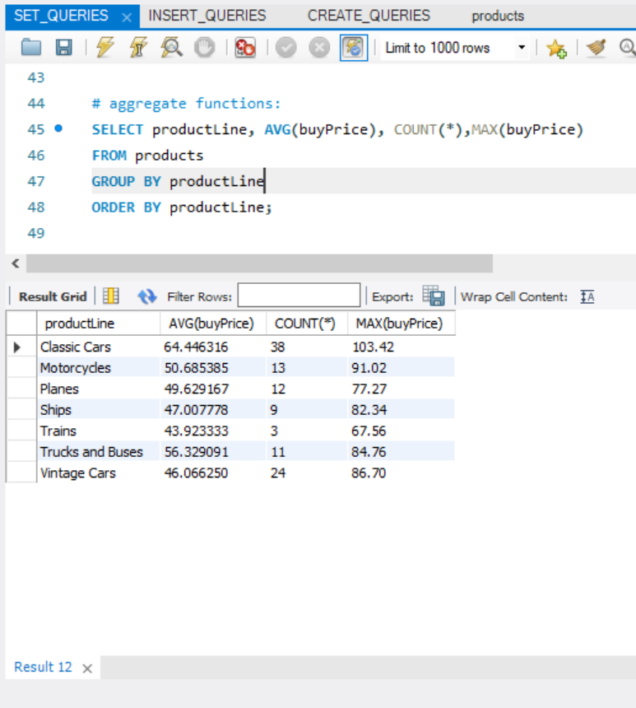
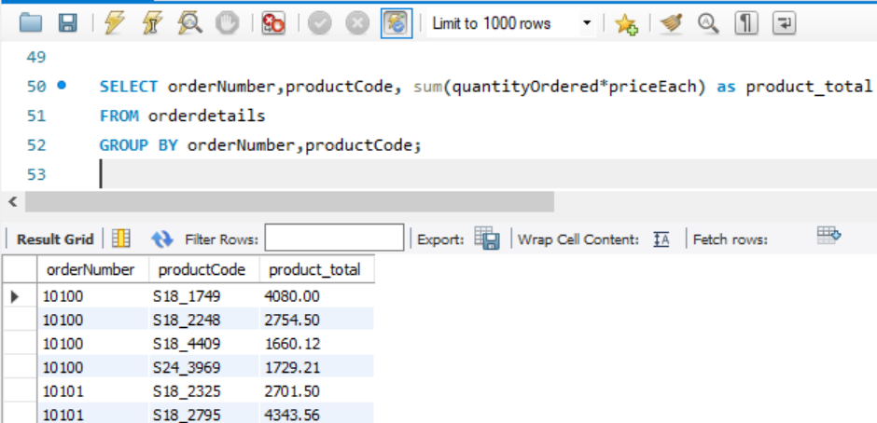
Aggregate Functions
AVG(buyPrice)
COUNT(*)
MAX(buyPrice)
SUM(quantityOrdered*priceEach)
Retrieve a single value after performing a calculation on a set of values. In general, aggregate functions ignore null values. Often, aggregate functions are accompanied by the GROUP BY clause of the SELECT statement.

Slide 16
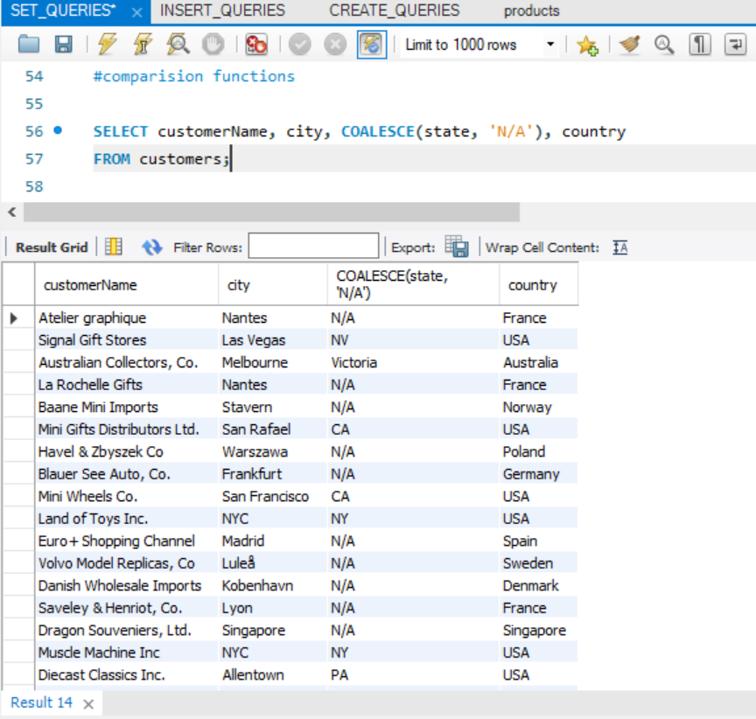
Comparison Functions
COALESCE(state, 'N/A’): in prev. slides we saw how to use if, to replace null values with ‘N/A’. Now we do the same using colalesce. This returns first non, null argument.
Other e.g. greatest(), least() , takes list of arguments and returns greatest/least argument respectively

Slide 17
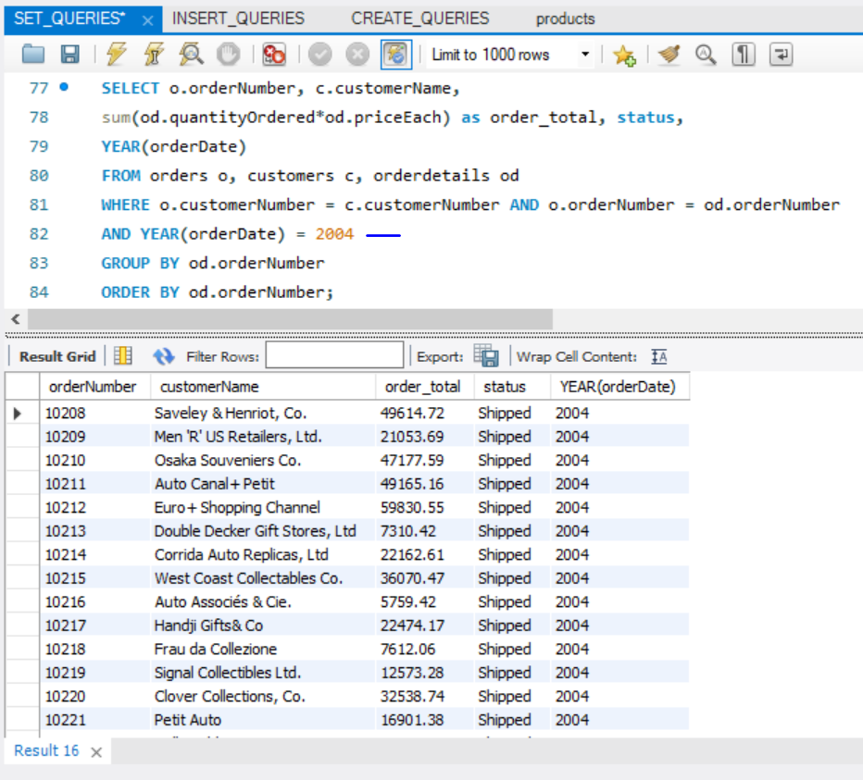
DATE Functions
This query returns all the orders along with the customer name who ordered it and order status for all orders in the YEAR 2004.
Ignore the JOIN – we will look into it in the upcoming slides. Focus on YEAR function, it takes, date as input and returns year
Few common ones are now(), currdate(), datediff(), dayofweek() etc

Slide 18
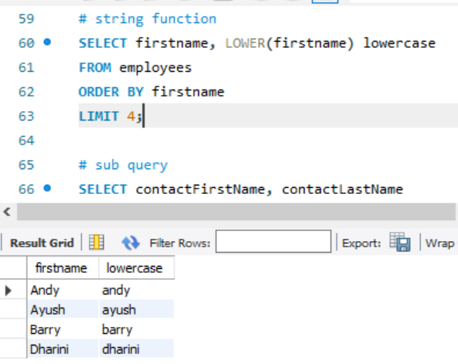
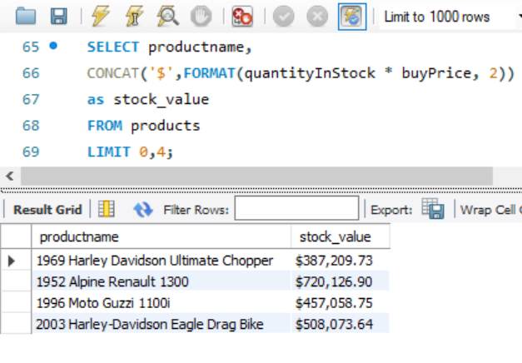
STRING Functions
concat() we saw previously.
lower() – converts string into lowercase
format(n,d): used to format numbers
The n is the number that you want to format.
The d is the number of decimal places that you want to round

Slide 19
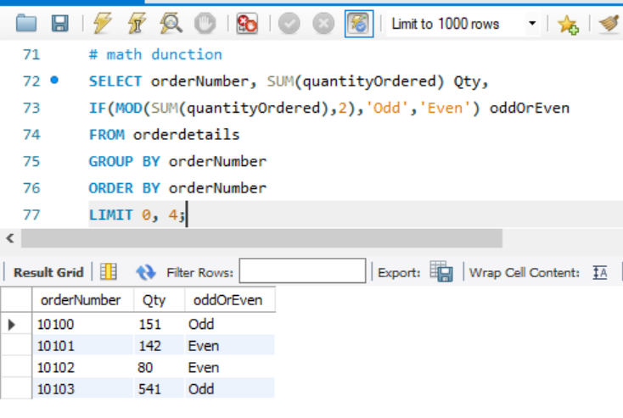
MAth Functions
Sum() we have seen previously
Another example, mod()
To find out if the ordered quantity is positive or negative
Ceil(), floor(), round() are few more rounding off functions

Slide 20
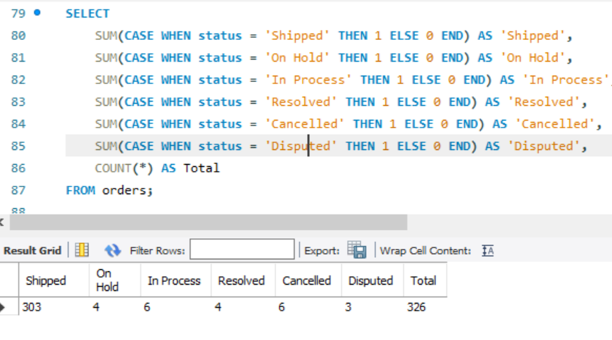
CONTROL FLOW
Prev. we saw if()
Lets now look into case when:
QUERY EXPLANATION:
Counts total number of orders with mentioned status, displays result per status using CASE WHEN
Case when is usually used in scenarios where multiple if then else conditions occur based on change in the value of one attribute, IF and case when, come extremely handy in writing stored functions, procedures, triggers, views

Slide 21
WHEN LOOKING INTO DATE FUNCTIONS, WE CAME ACROSS ADVANCE CONCEPT OF JOIN! LET’S TAKE A DEEPER LOOK INTO IT

Slide 22
ABOUT JOINS..
Usually, in relational databases, tables are connected with each other using foreign keys – primary key linkages. These linkages form as a result of table Normalization. It allows us to access different columns of different tables, using the matching ID -> this is known as join condition
DEFINITION: JOIN clause is used to combine rows from two or more tables, based on a related column between them.
(INNER) JOIN: Returns records that have matching values in both tables
LEFT (OUTER) JOIN: Returns all records from the left table, and the matched records from the right table
RIGHT (OUTER) JOIN: Returns all records from the right table, and the matched records from the left table
FULL (OUTER) JOIN: Returns all records when there is a match in either left or right table

Slide 23
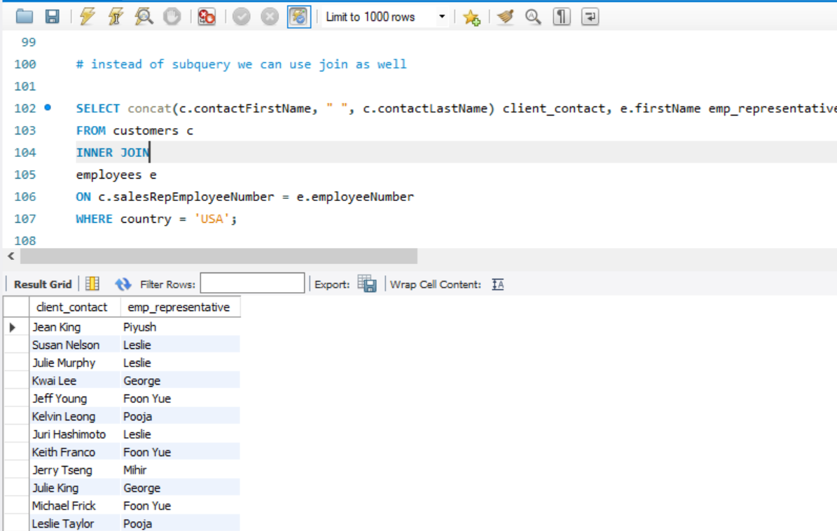
INNER JOIN
QUERY EXPLANATION:
In customers table there is a column called salesRepEmployeeNumber Which foreign key belonging to Employees, employee number. These 2 were joined to give us the name of customer_contact_person and their corresponding client representive
Note that table aliasing is done to make it easier to refer table.columns

Slide 24
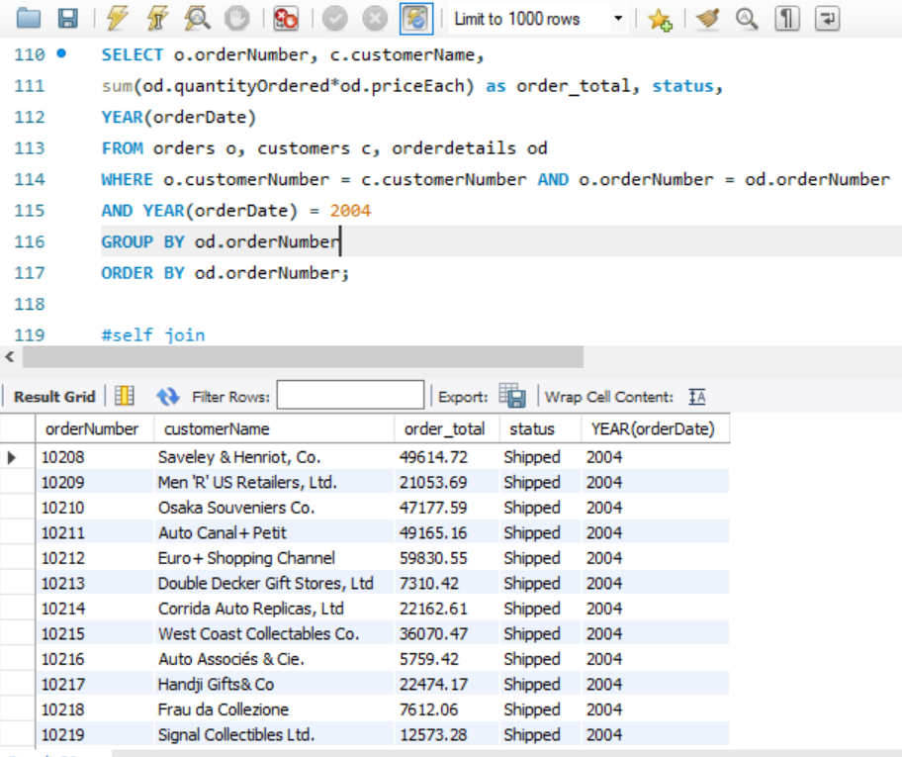
INNER JOIN
QUERY EXPLANATION:
Implicit join using where clause.
Fetching status and customer info of all orders placed in the year 2004.
Notice over here, INNER JOIN is not specifically mentioned; however due to = in where clause matching the 2 id’s, implicit INNER JOIN tables place

Slide 25
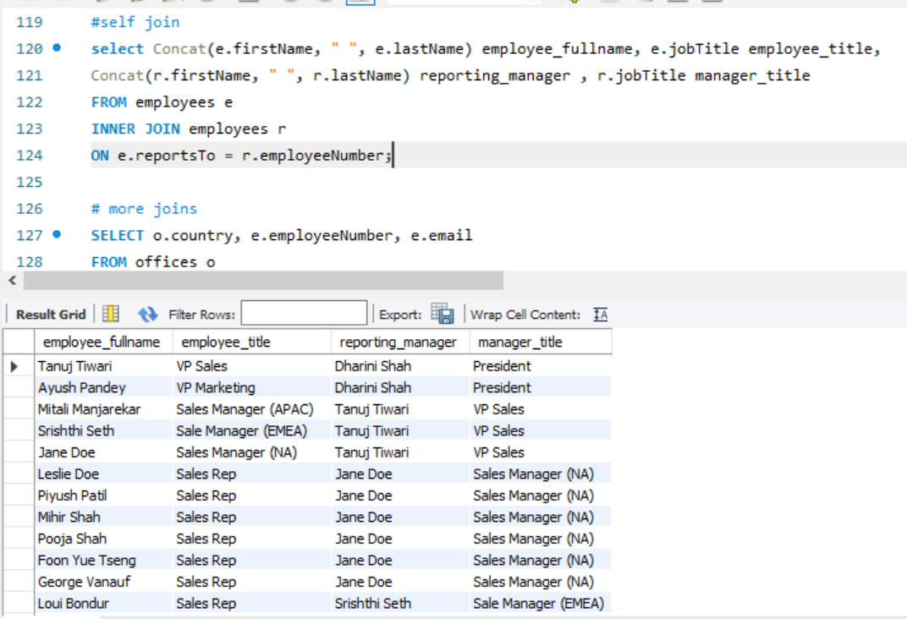
SELF JOIN
QUERY EXPLANATION:
Employee table is self joined with itself to fetch us the names of each employee and their supervisor.
We have also fetched employee’s title and supervisor’s title.
JOIN CONDITION:
e.reportsTo = r.employeeNumber
Here, reportsTo and employeeNumber, both are id’s belonging to same employee table.
In simple terms, it means, every supervisor is also an employee.
IMP

Slide 26
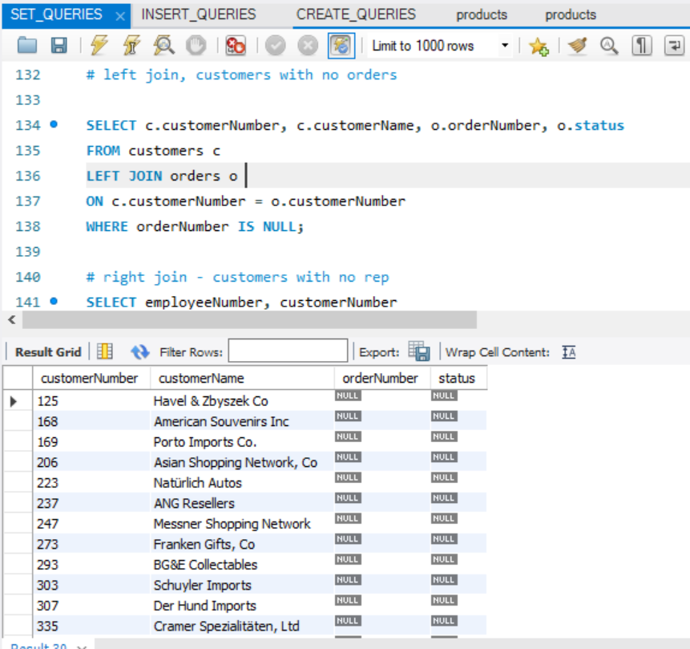
LEFT JOIN
QUERY EXPLANATION:
LEFT join takes all the rows in the left table and match rows in the right table. For remaining rows, in left table, its substitutes NULL. Using this, we are fetching all the customers that have no orders, in other words customers for whom order number is NULL
IMP

Slide 27
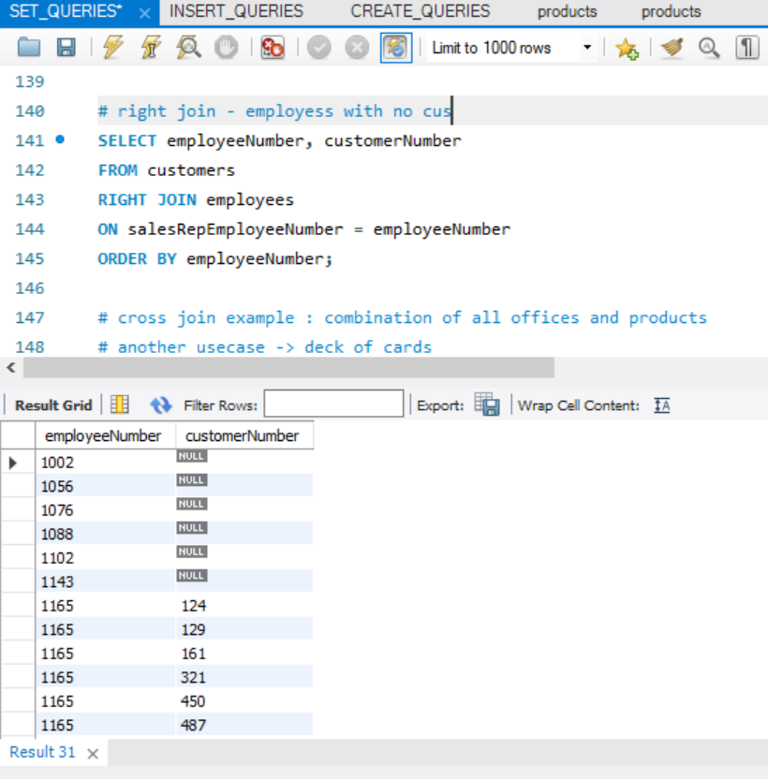
RIGHT JOIN
QUERY EXPLANATION:
RIGHT join takes all the rows in the right table and matching rows in the left table, based on join condition. In this case we have fetched all employees and customers represented by those employees -> so in customer Number where column value is null, represents those employees that DONOT represent any customer

Slide 28
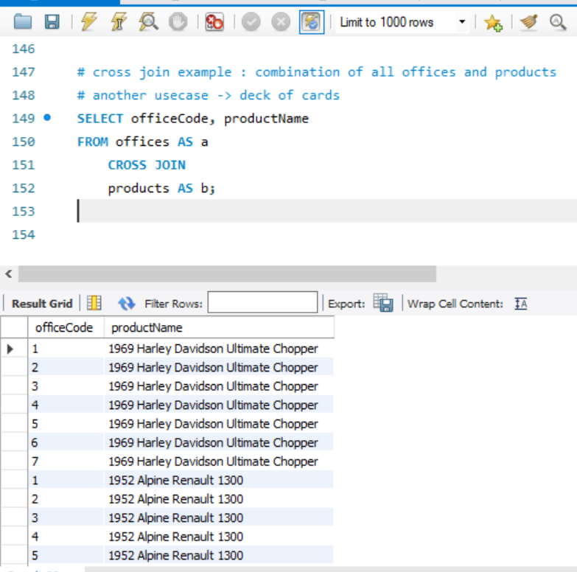
CROSS JOIN
Another special kind of JOIN is cross join -> it doesn’t have any matching condition. Its basically is a cartesian product. Meaning, take every row in table 1, multiply it with every row table 2. Example shown.
Use cases of CROSS JOIN usually involve generating test inputs, or combinations. Example if I have 5 cars and 3 colors -> I can do a cross join to get every car in every other color.

Slide 29
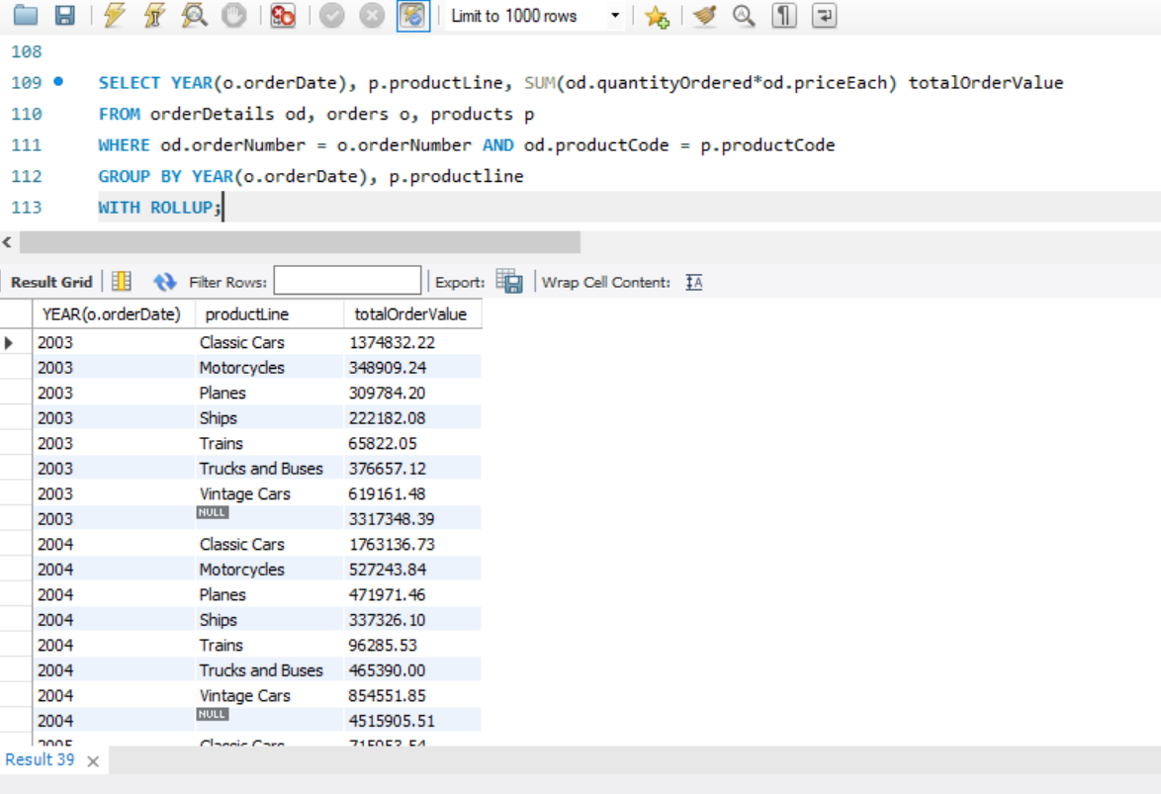
ROLL UP
Rollup is usually combined with aggregate functions and let’s you summarize data – very important from a statistical point of view. It shows you the subtotals per group by columns, and final grand total for each column.
EXAMPLE SHOWN:
This query shows – product sales data per year, per product line
Product line wise total, and then year wise grand total
Also, notice how 3 tables are easily joined using 2 implicit joins making code cleaner to read

Slide 30
NEXT TOPIC, SUBQUERIES

Slide 31
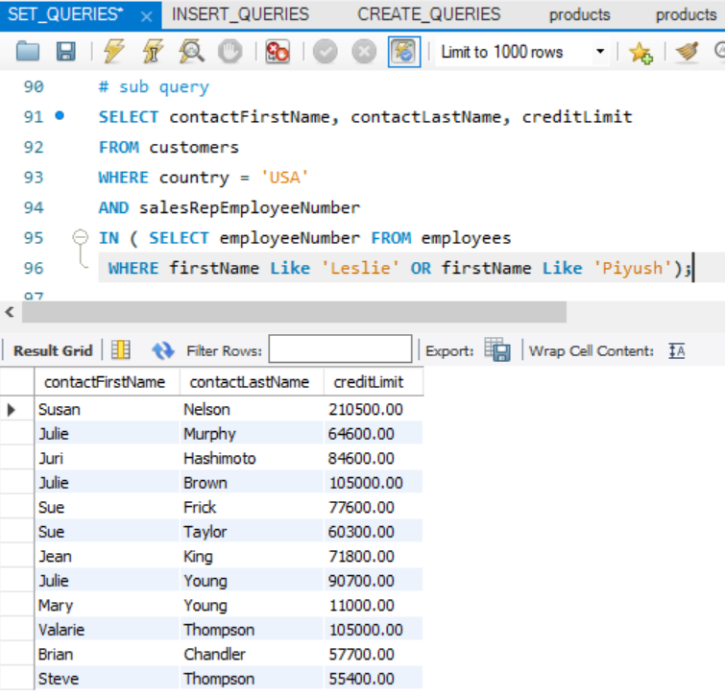
SUBQUERIES
A subquery is a SQL query nested inside a larger query
A subquery may occur in:- A SELECT clause
- A FROM clause
- A WHERE clause
Usually, all operations that can take place using a join, can also take place using a sub query. Example shown.
In case of subqueries, always start evaluating from innermost query. Thus, output of innermost query will be emp number for Leslie or Piyush. Outer query will thus give us, list of all customers from USA, whose representatives are leslie or Piyush. Notice the use of in operator. As subquery returns more than one value, we are using IN Operator

Slide 32
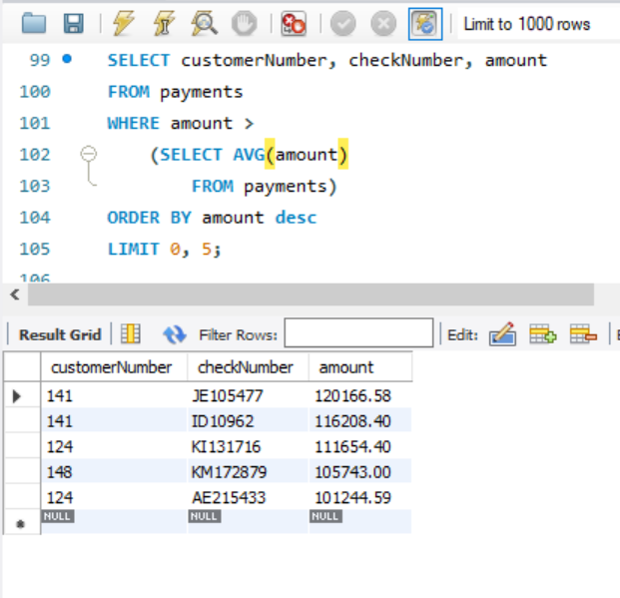
SUBQUERIES
This sub query gives us TOP 5 customers whose payment amount is greater than average amount.
First select avg amount from payment
Then use it to compare with amount for each customer
Order the query in descending order, and fetch top 5 records by Limit 0,5
IMP

Slide 33
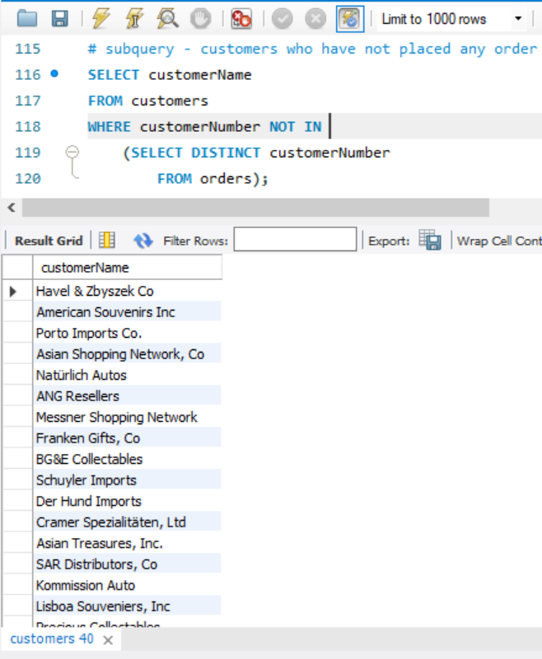
SUBQUERIES
This sub query gives us customers that haven’t placed any orders.
First fetch distinct customer numbers from orders table – this will give you customers that have placed orders, then -> using not in fetch customers that are not in this list from customers table -> this will give you customers that haven’t placed any orders
IMP

Slide 34
References:
Links/Tutorials:
https://programmingwithmosh.com/
BOOKS:
Modern Database Management, Book by Jeffrey A. Hoffer
Beginning SQL, Book by John Colby and Paul Wilton
Beginning MySQL, Book by Robert Sheldon

Slide 35
THANKYOU!!!

